Slide 1
2nd session: Ownership of copyright and performers' rights
Carlo Scollo Lavizzari
Advokat (Basel-Stadt), Solicitor (England & Wales), Attorney (Südafrika, non-practising roll)
carlo.lavizzari@gysinrecht.ch

Slide 2
Recognition of Authors and Performers & effective allocation of rights for enforcement
A. First Aim: recognising authorship
- Usually by awarding first ownership to creative
- Economic rights
- Moral rights
- Inroads and defaults deviating historically
- Co-authorship, multi-author works, collective performances
- Permitting assignment of future works
C. Secondary Publication Right – A New Risk
- large downstream users seek to allocate “rights” with authors, but not to strengthen copyright but to weaken negotiation position of publisher.
- Results in weakenig of rights, unenforceability or, worse, obligation to exercise or transfer rights to downstream user through statutes, labour law or by-laws.
- Examples:
so-called “secondar right of publication”, Creative Commons and AI, Creative Commons and moral rights
B. Second Aim: facilitate enforcement:
- Initial ownership with publisher/producer
- Right to bring action limited to CMO
- Generally sound if no mission creep
- Absent from moral rights enforcement –
time for a re-think.
D. Conclusion
- The case to allocate ownership other than in hands of authors and performers is weak but sometimes justified in interest of a better enforcement of rights
- public generally more knowledgeable about
economic rights of creatives → deviation from default less needed
- for moral rights the jury is out whether some allocation for enforcement should not be allowed at least as default or option

Slide 3
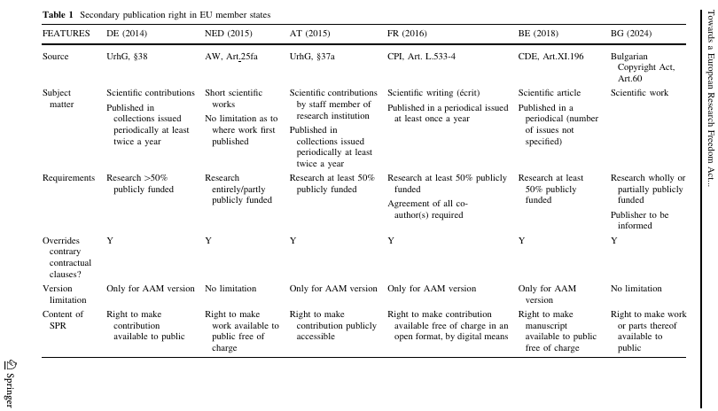
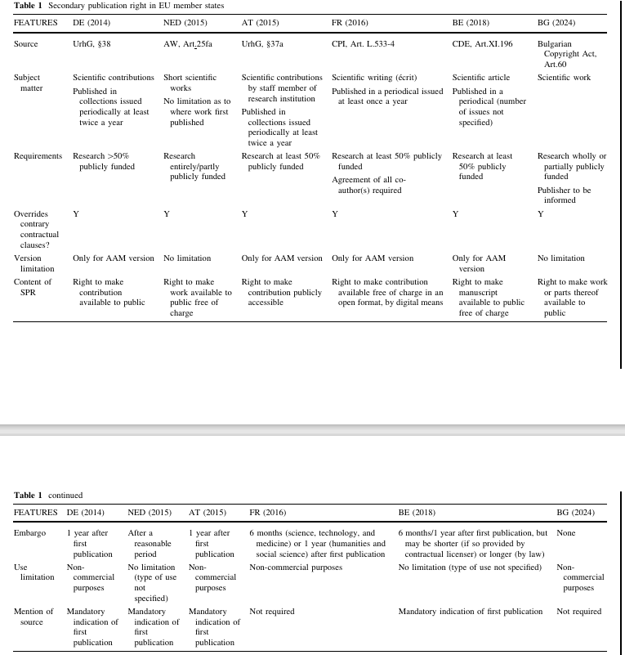
Secondary Publication Right in EU Member States:
Notes:
Towards a European Research Freedom Act: A Proposal for an EU-Wide Secondary Publication Right
Caterina Sganga, Thomas Margoni, Martin Senftleben, Kacper Szkale, 22 July 2025, IIC - International Review of Intellectual Property and Competition Law, Springer:
“However, from the publishers’ perspective, embargo periods are of particular importance. They limit the impact of SPR regimes on existing business models and on the primary exploitation of research output. Proposals to reduce or eliminate embargo periods after the first publication carry the risk of substituting the published product with the secondary publication. Overall, 62.1% of publishers surveyed indicated that no or minimal embargo periods would require a fundamental reshaping of their business model.125 Broken down by type, 71.4% of commercial publishers, 23.1% of institutional publishers, and 65.0% of non commercial publishers reported that abandoning embargo periods would necessitate such a change.126”
124European Commission et al. (2024), p. 140.
125 Ibid. p. 104.
126 Ibid. p. 179.

Slide 4
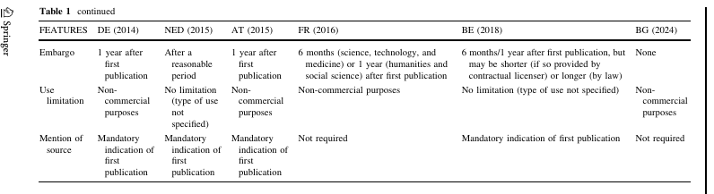
Secondary Publication Right in EU Member States (continued):

Slide 5


Not everything that counts is countable and not everything that is countable counts.
William Bruce Cameron,
Informal Sociology, Random House NY, 1963
Contakt
Carlo Scollo Lavizzari
Gysin Attorneys Basel, Switzerland
Hirzbodenweg 95, 4052 Basel
carlo.lavizzari@gysinrecht.ch
Notes:
1963, Informal Sociology, a casual introduction to sociological thinking by William Bruce Cameron, Page 13, Random House, New York. (Google Books snippet view) (Checked on paper: Fifth printing, January 1967; Copyright 1963) link

Slide 6
THANK YOU FOR YOUR ATTENTION!

